Slide 1


DAYANANDA SAGAR UNIVERSITY
SCHOOL OF ENGINEERING
Computer Science and Engineering (AIML)
Minor Project Phase-I
JOB PORTAL SYSTEM
Under the Supervision
Prof. Bhuvana Mohini Mam
Presented By:
Girish Babu M B (ENG24AM0176)
M R L Arjun Reddy (ENG24AM0348)
P V S Puneeth Reddy (ENG24AM0248)
Raviteja L (ENG24AM0075)
DAYANANDA SAGAR UNIVERSITY
Notes:
Title of the project
CSE Dept., SET-Jain University

Slide 2
TITLE: JOB PORTAL SYSTEM
Girish Babu M B (ENG24AM0176)
M R L Arjun Reddy (ENG24AM0348)
P V S Puneeth Reddy (ENG24AM0248)
Raviteja L (ENG24AM0075)
Project guide: Prof. Bhuvana Mohini
Assistant Professor
Dayananda Sagar University
Bengaluru, Harohalli
DAYANANDA SAGAR UNIVERSITY
(#) of 12

Slide 3
Content
Introduction
Literature Review
Problem Statement
Aim & Objectives
Methodology
Results and Discussion
References
DAYANANDA SAGAR UNIVERSITY
<number> of 12

Slide 4
Introduction
A Job Portal System is a web-based application that connects job seekers with employers. It provides a centralized platform where users can search for jobs, apply online, and manage recruitment efficiently.
DAYANANDA SAGAR UNIVERSITY
<number> of 12

Slide 5
Literature Review
Traditional recruitment methods are slow and inefficient
Platforms like LinkedIn and Naukri offer job matching but lack personalization and simple UI.
There is a need for a customizable, scalable, and user-friendly job portal system
DAYANANDA SAGAR UNIVERSITY
<number> of 12

Slide 6
Problem Statement
Manual recruitment processes are inefficient, slow, and lack transparency.
There is a need for a system that simplifies job posting, application tracking, and communication between employers and job seekers.
Eg:
  Problem: “Job seekers struggle to find relevant job opportunities, while employers face difficulty in managing applications efficiently due to manual and fragmented recruitment processes.”
  Solution: “Develop a web-based Job Portal System using modern full-stack technologies (e.g., React, Node.js, and MongoDB) to enable job posting, application tracking, and seamless communication between employers and job seekers.”
  Research gap: “Existing platforms often lack personalization, simple user interfaces for beginners, and customizable features, highlighting the need for a more user-friendly and scalable job portal system.”
DAYANANDA SAGAR UNIVERSITY
<number> of 12

Slide 7
Aim & Objective
Aim: To develop a web-based job portal system for efficient recruitment.
Objective:
1. Enable user registration and login.
2. Allow employers to post jobs
3. Allow job seekers to apply for jobs
4. Manage applications effectively
5. Provide a user-friendly interface
Methodology: “The project follows a structured development approach involving requirement analysis, system design (frontend, backend, and database architecture), implementation using full-stack technologies, and testing to ensure a scalable, efficient, and user-friendly Job Portal System.”
DAYANANDA SAGAR UNIVERSITY
<number> of 12

Slide 8
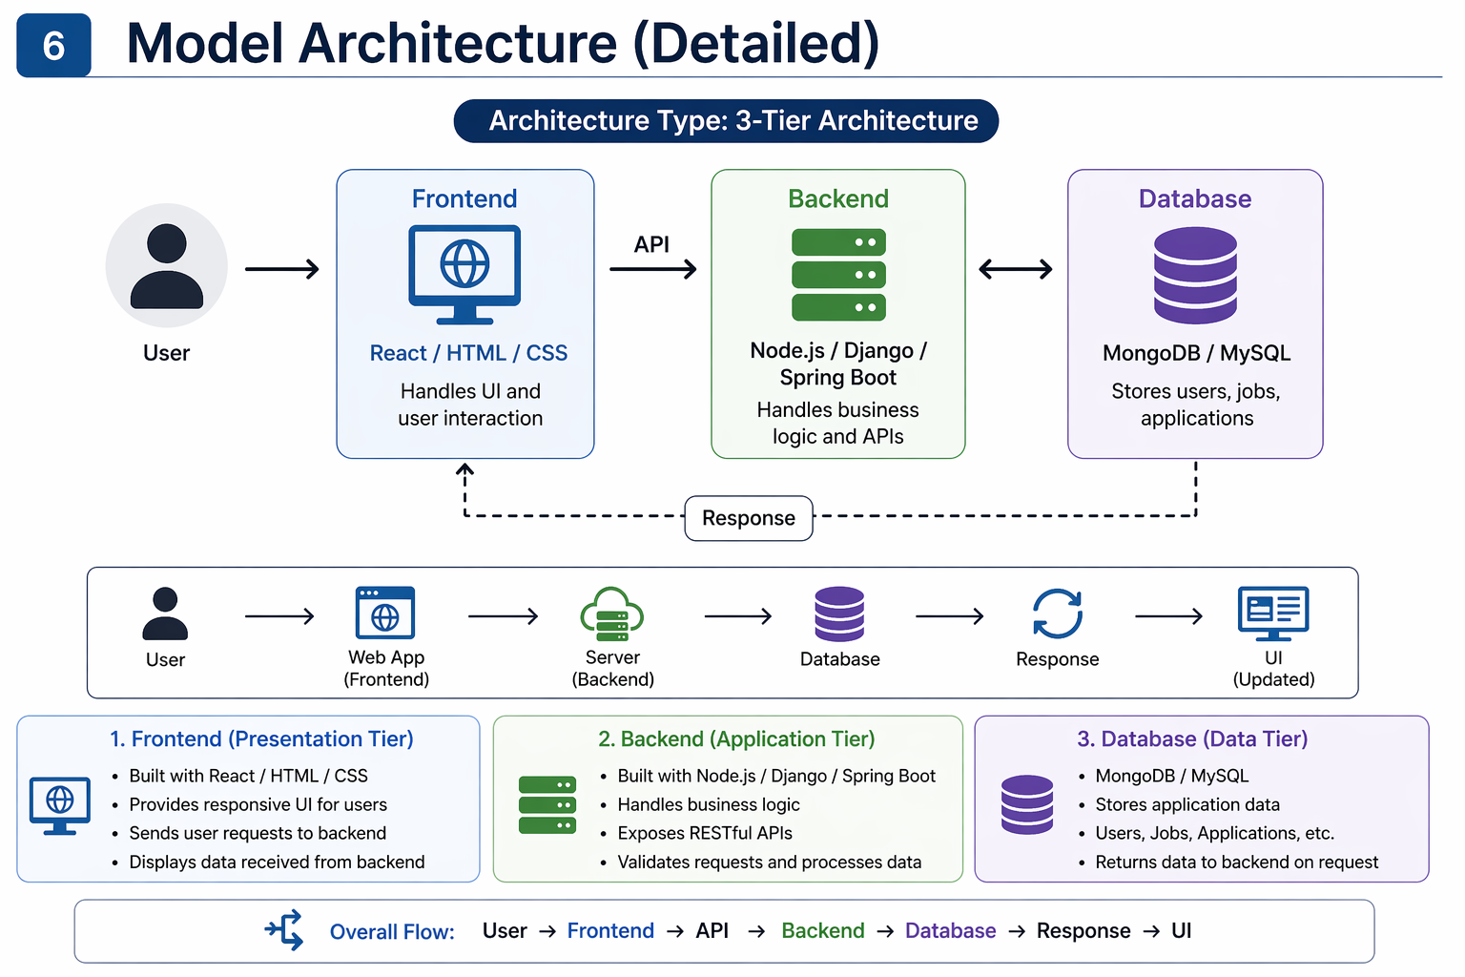

Model Architecture in detail
DAYANANDA SAGAR UNIVERSITY
<number> of 12

Slide 9
Methodology:
Agile development approach
Modules developed step-by-step:
1. Authentication (Register/Login) ✔️
2. Job posting
3. Job application
4. Resume upload
Testing after each module.
Integration of all modules.
DAYANANDA SAGAR UNIVERSITY
<number> of 12

Slide 10
Results and Discussion:
RESULT:
Successfully implemented login and registration.
System allows job posting and application.
Efficient data storage and retrieval.
User-friendly interface.
CONCLUSION:
Reduces manual effort.
Faster hiring process.
Scalable for future enhancements.
DAYANANDA SAGAR UNIVERSITY
<number> of 12

Slide 11
References
[1] D. Y. N and K. Kajal, “Job Portal System Using Full Stack Development,” International Journal of Scientific Innovation and Engineering, 2025.
[2] A. A. Riaz, “Online Job Portal System for Efficient Recruitment Process,” ResearchGate Publication, 2023.
[3] R. H. Tarek, “Development of a Web-Based Job Recruitment System,” ResearchGate Publication, 2024.
DAYANANDA SAGAR UNIVERSITY
<number> of 12

